Slide 1
DIGITAL PORTFOLIO
STUDENT NAME: MATHANI A
REGISTER NO. AND NMID:24131060500122029,31667B1DFEE3F59828F460A50B7F4B44
COLLEGE /UNIVERSITY: Shree RAGHAVENDRA Arts and Science College, Annamalai University
DEPARTMENT:BCA 2^{ND YEAR}

Slide 2
PROJECT TITLE
Digital Portfolio
A Digital Portfolio is a personal website that displays an individual’s skills, education, project and achievement in a well-organized and attractive format. It is designed using HTML, CSS and optionally JavaScript to create a simple and responsive layout.

Slide 3
Agenda
Problem statement
Project overview
End user
Tools and techniques
Portfolio design and layout
Features And functionalities
Results and screenshots
Conclusion
GitHub link

Slide 4
PROBLEM STATEMENT
Problem statement
To design and develop a personal portfolio website for a BCA student that displays details such as profile, education, skills, and contact information in a simple and responsive manner. The website should: Provide smooth navigation across sections like Home, About, Skills, Education, and Contact. Present information clearly with an attractive layout. Work on both mobile and desktop devices.

Slide 5
PROJECT OVERVIEW
Project Overview – Digital Portfolio Website: 1. Project Title: Personal Digital Portfolio Mathani a – BCA Student 2. Objective: To design and develop a responsive portfolio website to showcase academic background, skills, and contact details professionally.

Slide 6
PROJECT OVERVIEW
3. Key Features:
Navigation Bar – Links to Home, About, Skills, Education, and Contact sections. Hero Section – Displays name, title, location, and social links. About Section – Overview of education and career interests. Skills Section – Programming skills in Python, C++, and C. Contact Form – Allows visitors to get in touch via email. Responsive Design – Compatible with mobile and desktop devices.

Slide 7
PROJECT OVERVIEW
4. Technologies Used: HTML5 – Structure of the website. CSS3 – Styling and layout design. Font Awesome – Icons for visual enhancement. JavaScript – Interactive features (toggle menu, contact form).
5. Expected Outcome: A professional-looking personal portfolio website that highlights academic and career achievements, helping in internships, job applications, and professional networking.

Slide 8
WHO ARE THE END USERS?
Main Categories of End Users:
Potential Employers / Recruiters:
Use it to review your skills, education, and contact info for internships or job opportunities.
College Faculty / Academic Evaluators:
Refer to it to assess your project work, presentations, and technical knowledge.
Peers / Collaborators:
Fellow students, developers, or friends who may want to collaborate on projects.
General Visitors:
Individuals interested in learning about your background, skills, and academic journey.

Slide 9
TOOLS AND TECHNIQUES
Tools Used;
HTML5 – Structure and content of the website. CSS3 – Styling, layout, and visual design. Font Awesome – Icons for navigation and sections. JavaScript – Interactivity (menu toggle, form handling). Code Editor (codepen / easy coder web/w3school) – For writing and editing Chrome code. Web Browser (Chrome) – For testing and running the website.

Slide 10
TOOLS AND TECHNIQUES
Techniques Used;
Responsive Web Design (RWD) – Ensuring website works on mobile, tablet, and desktop. Navigation Bar Design – Smooth section linking for user-friendly experience. Section-Based Layout – Dividing content into Hero, About, Skills, Education, and Contact sections. Form Handling Technique – Collecting user input in the contact form. Use of External Libraries – Font Awesome for icons.

Slide 11
PORTFOLIO DESIGN AND LAYOUT
Design
Minimal & Professional Look – Clean and simple interface with a focus on content. Font Awesome Icons – For visual appeal and navigation clarity. Color Scheme – Soft background with readable text contrast. Typography – Clear headings and readable body text.

Slide 12
PORTFOLIO DESIGN AND LAYOUT
Layout
Navigation Bar – Fixed menu with Home, About, Skills, Education, and Contact sections. Hero Section – Name, title, location, and quick action buttons (LinkedIn, Contact). About Section – Personal introduction and highlights (Education Focus, Interests, Goals). Skills Section – List of technical skills (Python, C++, HTML, Javascript). Contact Section – Contact details, social links, and message form. Footer – Copyright and brief info.

Slide 13
FEATURES AND FUNCTIONALITY
Features
Responsive Design – Works on desktop, tablet, and mobile. Navigation Bar – Easy access to all sections (Home, About, Skills, Education, Contact). Hero Section – Profile name, title, and location displayed prominently. Interactive Buttons – LinkedIn and contact links open directly. Font Awesome Icons – For better visual representation of sections. Contact Form – Users can send messages directly. Footer – Displays copyright and basic information.

Slide 14
FEATURES AND FUNCTIONALITY
FUNCTIONALITY
Smooth Scrolling between sections using navigation links. Clickable Social Media Buttons to redirect to LinkedIn. Form Submission to collect visitor messages (can be linked to email or database in future). Mobile-Friendly Layout ensuring proper alignment across all devices.

Slide 15
Results and screenshots
Results
A fully functional Personal digital portfolio website Was Created.
Showcase Profile, skills And contact information In an interactive layout.
Responsive design Works seamlessly On desktop and mobile Devices.
Provides easy navigation and Direct LinkedIn integration.

Slide 16
Screenshots

Slide 17
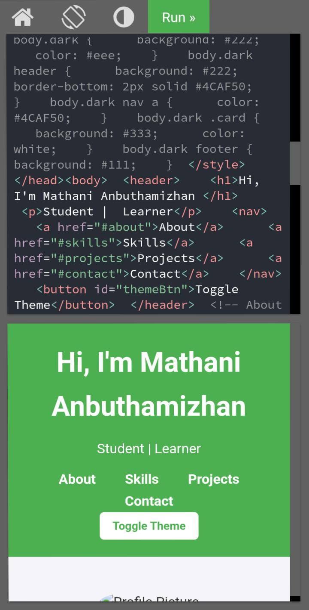
Homepage – showing name, Title and Details

Slide 18
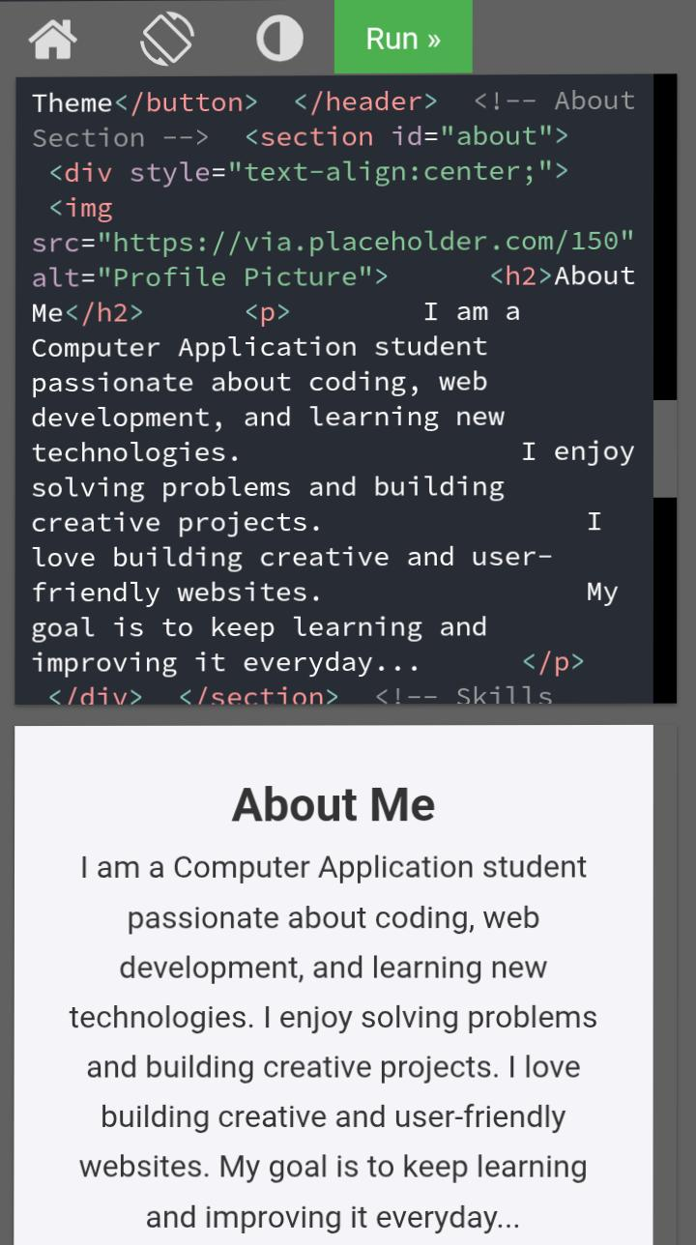
About section – displaying bio and Highlights

Slide 19
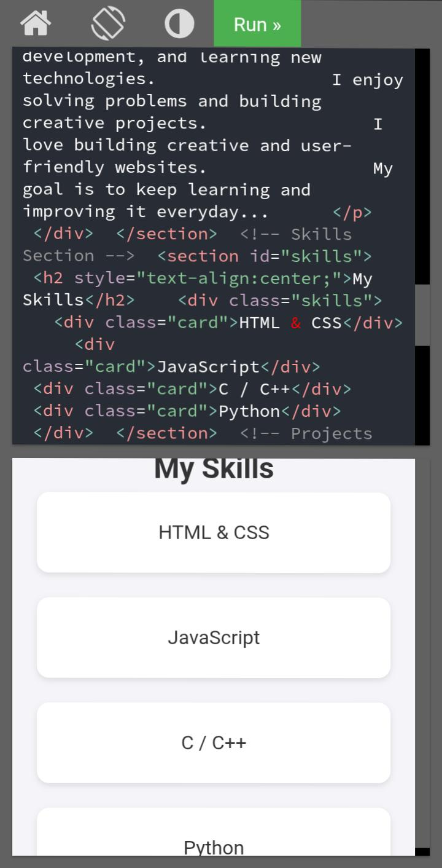
Skills section– listing programming language

Slide 20
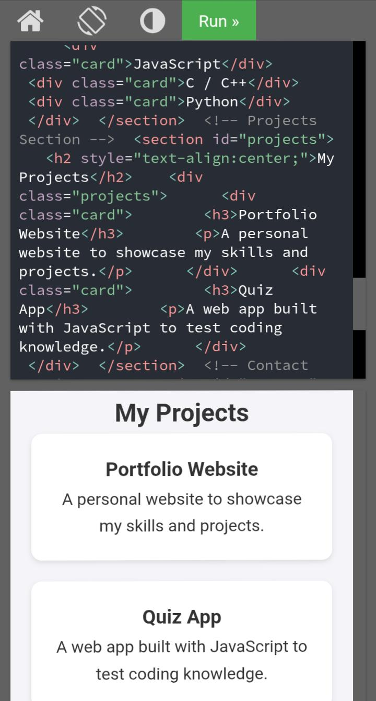
Project section– to show projects

Slide 21
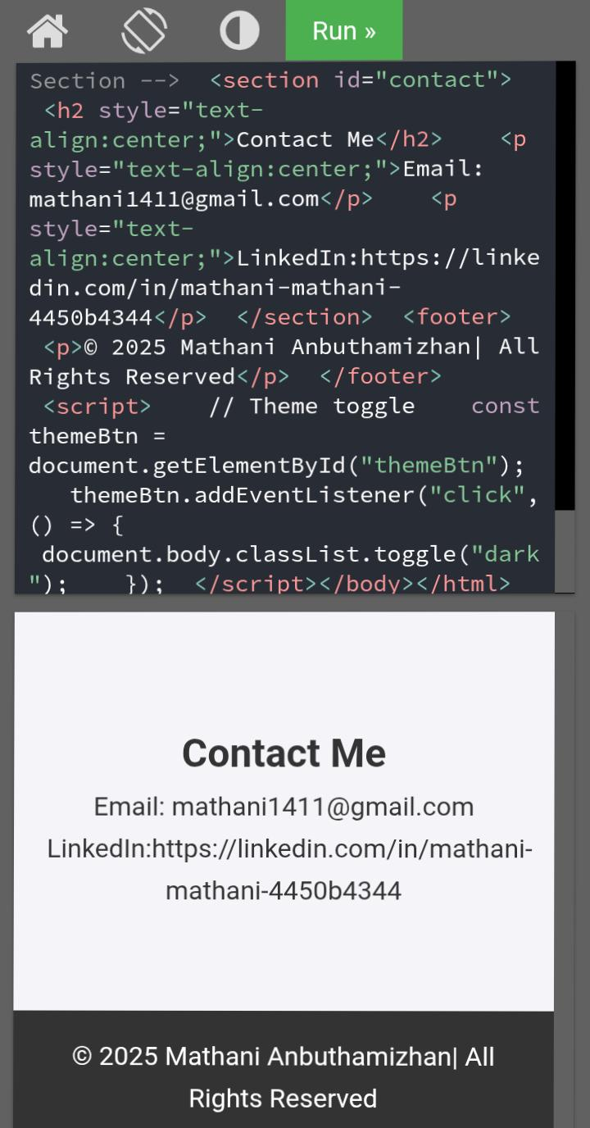
Contact section – email, LinkedIn

Slide 22
Conclusion
Conclusion for Digital Portfolio Project “The Digital Portfolio effectively showcases my personal profile, academic background, technical skills, and career aspirations in an organized and visually appealing format. It serves as a professional platform for potential employers, faculty, and collaborators to learn about my abilities and achievements. The project demonstrates my knowledge of web development using HTML, CSS, and JavaScript and highlights my capability to create user friendly and responsive designs.” “THANK YOU”

